Slide 1
MANAGE SUCCESSFUL FIELD RESEARCH 2024

Slide 2
Stata: Introduction to Statistical Programming & Reproducibility
Roshni Khincha
Research Analyst

Slide 3
Outline
Overview of Stata Labs
Statistical programming
Intro to Stata
Data in Stata
Exploring data
Non-Stata data
Main do-files

Slide 4
Overview: Stata Labs
Introduction to Stata
Data Cleaning & Tidying
Descriptive Analysis with tables
Descriptive Analysis with graphs

Slide 5
Today’s lab
Introduction to Stata
Data Cleaning & Tidying
Descriptive Analysis with tables
Descriptive Analysis with graphs

Slide 6
Statistical Programming

Slide 7
Data Work in Development Research
Starts with a data input
Runs some process with the data
Produces an output with the result
More generally, for any of the processes in development research, we'll call data work everything that:
Primary or Secondary data
Statistical analysis, mathematical operations, or data transformations
Tables, figures, reports, etc.

Slide 8
What do we mean by Statistical Programming?
Programming consists of producing instructions for a computer to do “something”. From now on, we're going to refer to these instructions for data processes as code
Starts with a data input
Runs some process with the data
Produces an output with the result
“Something”
Instructions like:
- Read data
- Transform data
- Create indicators
- Export results

Slide 9
Reproducibility
In science, the formal definition of reproducibility was provided by Bollen et al. (2015):
the ability […] to duplicate the results of a prior study using the same materials and procedures as were used by the original investigator
This translates to data work as:
The ability to reproduce outputs using the same code and data inputs.
This is also usually referred to as computational reproducibility.

Slide 10
Principles of Statistical programming
Your code is an output
Know your data
Write code for others to read
Think critically
Ask for help
Keep improving your skills

Slide 11
Excel vs. Stata
Why are we writing code scripts instead of using Excel?
In Excel you make changes directly to the data and save new versions of the dataset.
In Stata you make changes to the instructions on how to get from the original data to the final analysis and save new versions of the instructions

Slide 12


Your code is an output: Create recipes, and not meals
When we are eager to get to our meal (result), we are tempted not to write recipes
We often assume that we will remember what we did and why, but that is not always the case if we did not write things down
In the end, we may spend a lot of time and effort trying to reinvent a recipe we had already invented!
Our recipe (code scripts, data documentation, etc.) is as important as our meal (tables/graphs)
If we write recipes that create delicious meals, we can have them as many times as we want
Current and future team members will read and contribute to the same set of recipes and keep improving them

Slide 13
Know your data
Key ingredient: Tabular data
Key ingredient: ID variables
Tabular data is organized in rows and columns
Each row describes one individual or member of a class
Each column contains information about characteristics of the individuals being described
Each row contains the same number of cells (although some of these cells may be empty)
Each cell within a same column provides information the same property of the things described by each row
Make sure all your datasets have an ID variable
If the dataset that you have received does not have one, then creating it is your first task
IDs variables must be uniquely and fully identifying
We will talk more about what this means and how to test if a variable is uniquely and fully identifying in Stata later in this course

Slide 14
Lay out ingredients before cooking
Before we start cooking, we need to think about what we are trying to cook and what is the best way to cook it
How do I code so it is the most helpful for my team members?
How is my data structured?
How do I communicate the data structure in my project?

Slide 15
Think critically
Do I believe this number?
How do I expect these variables to relate to one another?
What can go wrong in my code?
How will missing values be treated in this command?
What would happen if some observations are added or removed from my dataset?

Slide 16
Intro to Stata

Slide 17
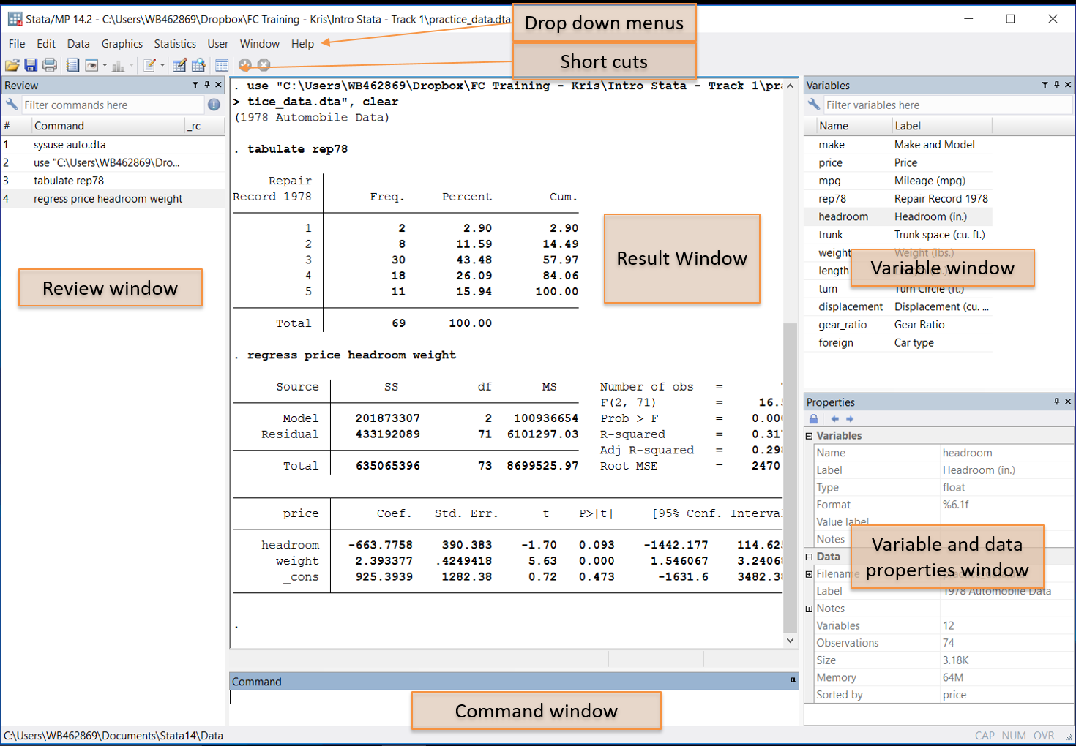
The Stata interface

Slide 18
How to tell Stata what to do?
Drop-down menus: An easy place to start but quickly becomes inefficient
Write code in the command window: Faster than menus but require that you are familiar with the command
Write code in a do-file: The only feasible way to run long instructions

Slide 19
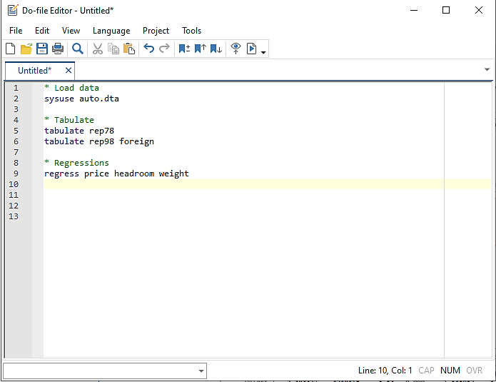
What are do-files?
Create a new do-file
It’s through the do-file you communicate your work to other members in your team, both current and future
Think of the do-files as instructions on how to get from raw data to final data/report
Also, for a simple task you can enter commands manually in the command window, but for more complex tasks you need to write a recipe, or a list of instructions
Run a do-file in Stata

Slide 20
Overview of data
The data for this analysis comes from an impact evaluation of Community-Based Conditional Cash Transfers (CCT) in Tanzania. This program aimed to replicate successful CCT models by involving communities in beneficiary targeting and payment distribution to improve outcomes for the poor.
There are 2 datasets:
treat_status.xlsx: Treatment status at community level
TZA_CCT_baseline.dta: subset of the baseline household survey conducted in January 2009.
The questionnaire is in the Documentation folder

Slide 21
Folder structure
DataWork
Data
Raw
Final
Code
Documentation
Outputs
treat_status.xlsx
TZA_CCT_baseline.dta
Template do files
Questionnaire

Slide 22
Opening a dataset

Slide 23
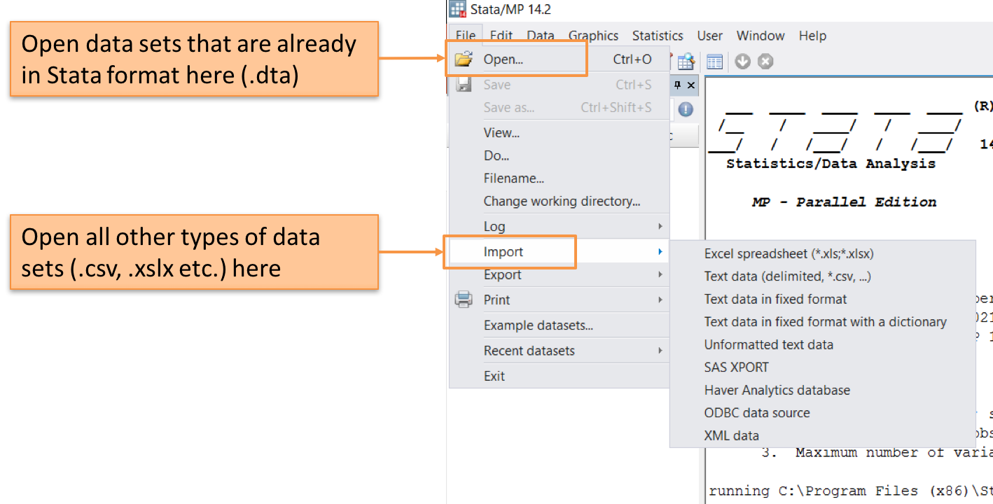
Opening a dataset using drop-down menu

Slide 24
Task 1A : Open the dataset
Load the dataset TZA_CCT_baseline.dta into Stata
1. Open Stata
2. Click on File > Open...
3. Navigate to DataWork > Data > Raw
4. Select the file called TZA_CCT_baseline.dta
5. Click Open
What happened?

Slide 25
Task 1B: Opening a dataset using command window
1. When you use the drop-down menus, Stata prints the code for that action in the results window. Highlight, right-click, and copy the code.
2. Paste the code in the command window.
3. Hit Enter.
What happened?

Slide 26
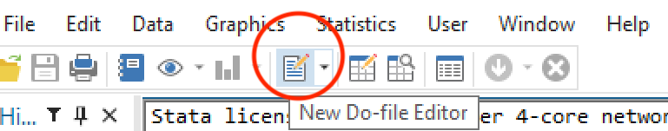
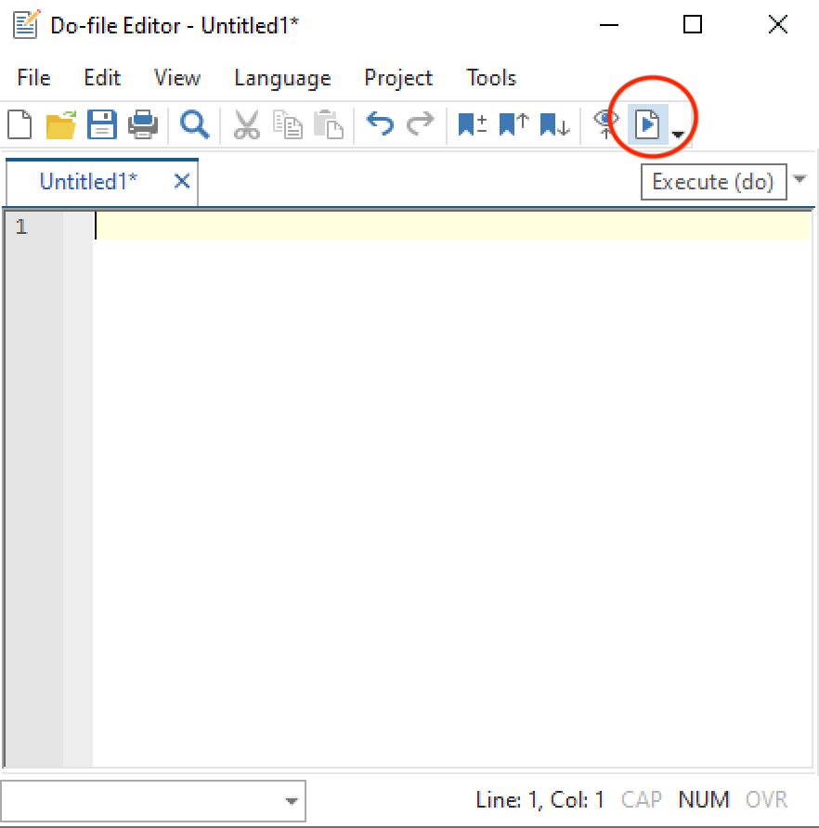
Task 1C: Opening a dataset using do-files
1. Open the do-file editor by typing doedit in the command window or through the shortcut icon on the top ribbon
2. Paste the code that opens the household survey data in the do-file
3. Press CTRL + D or click the shortcut icon to execute
Go back to the Stata console
What happened?

Slide 27
Opening dataset in Stata
You have just used all the three ways that can be used to interact with Stata
Using the point-and-click method through Stata’s user interface may seem the easiest way to interact with it
However, when we use this method, we are “cooking a meal”, not “writing a recipe”
Our preferred way to interact with Stata, the one we will focus on during this training, are do-files
Do-files are the last method you just tried
We prefer them over the over methods because they allow us to re-do every step we have taken in our work and re-create all its outputs

Slide 28
Review window
The review window provides records of your conversation with Stata
It is a convenient way to bring back your previous commands and modify it to do something new
Double click on a command you want to use again, and it will appear in your command window
You can also click in command window and select the commands in the result window by using PageUp/PageDown buttons
fn+ArrowUp/ fn+ArrowDown on Mac
If a command is red in the review window, it means it did not run because of an error

Slide 29
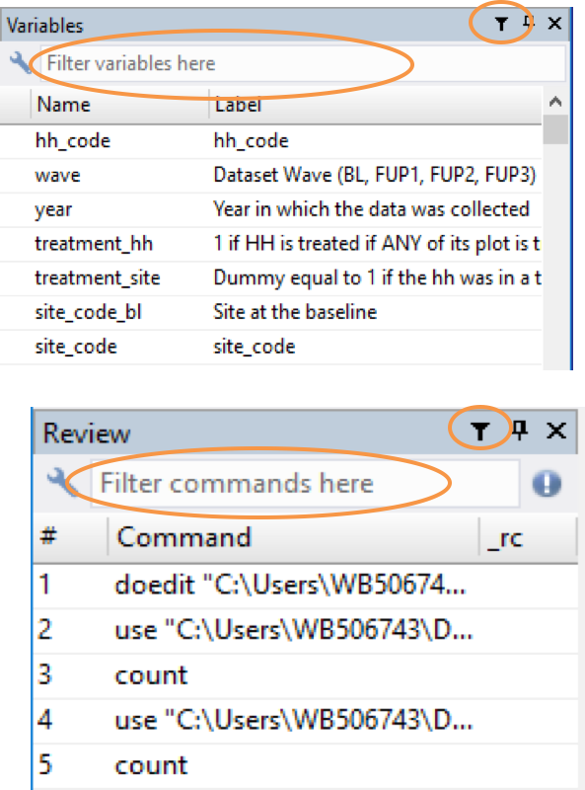
Searching variables and commands
Both the variable window and the review will soon be very crowded. You can then search commands and variables
If you do not see the search bar, click the little funnel symbol

Slide 30
Code syntax
Note that all the content of your conversation with Stata so far consists of lines with a single verbs
These are what we call commands
Commands are the equivalent of verbs in the Stata language
These verbs are pre-defined, and you need to use each of them in the correct way for Stata to understand you

Slide 31
Help files
When you are not sure how to use a command, you can look for help
To look for help, we use the help command
To see how it works, type help codebook in the command window and then press ENTER

Slide 32
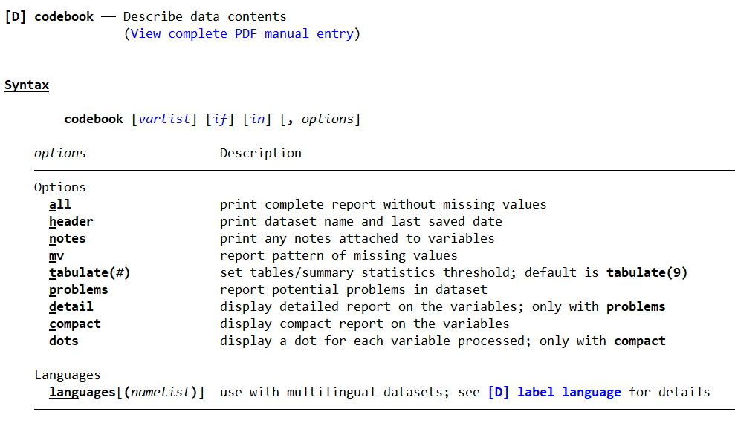
Help files
At the top of the help file, you will find a very short description of what the command does
Under syntax, you will know how to use the command correctly
Everything inside square bracket ([]) is not required
Whenever varlist is shown in a help file, it means the command takes a list of variable names as a complement

Slide 33
Error messages
When there is an error in how you used a command, Stata will print a message in red
This message explains what is wrong with your “sentence”
You can always Google the error if you can not understand it
Some commands can only be used with certain types of variables
In this case, we are trying to analyze text as if it were a number

Slide 34
Exploring datasets

Slide 35
Exploring a new dataset
browse: see all data in spreadsheet format
describe: list of all variables in memory
Total number of variables & observations (size of matrix)
Variable name, type, format, value label name, variable label
summarize: basic statistics for numeric variables
N, mean, standard deviation, min, max
summarize, detail: percentiles, variance, skewness, kurtosis
codebook: list of all the variables in memory
Type of variable, range, unique values, units, number of missing values and descriptive statistics or frequency table
tabulate: frequency tables
histogram: display distribution of a variable

Slide 36
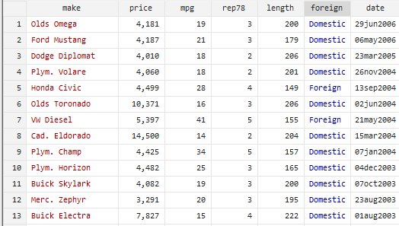
Types of variables
In Stata, each variable (column) must be either:
string (text) – values are red when browsing
numeric (number) – values are black or blue when browsing
Numbers can be stored as text, but text cannot be stored as number
It is not possible to do computations on numbers stored as text
Categorical variables are stored as numeric variables with value labels
Dates and times are stored as numbers, but can be shown in different formats

Slide 37
Task 2a: Explore the data
To start exploring, lets first set up our work environment:
Open the do-file lab1 in the Code folder.
Load the TZA_CCT_baseline dataset.
Explore the dataset using browse and document the following:
What is the unit of observation?
What are the different data types?
What are the total number of variables and observations?

Slide 38
Task 2b: Explore the data
Next, explore the dataset using following commands:
describe:
See the column storage type. What does it tell you?
summarize:
Are there any statistics that might not make sense to interpret?
What do they have in common?

Slide 39
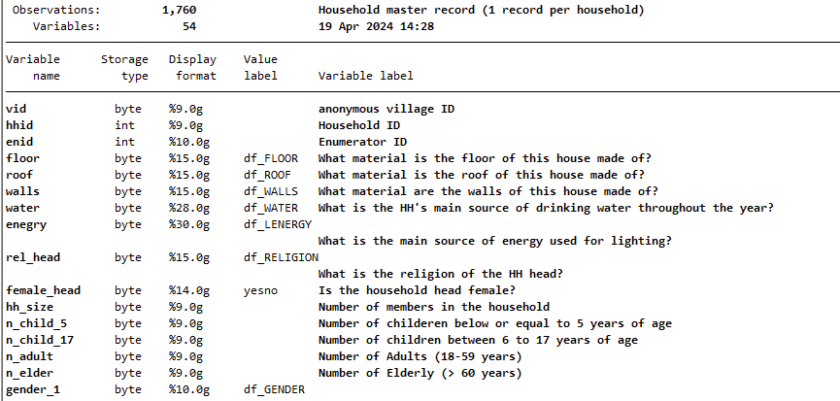
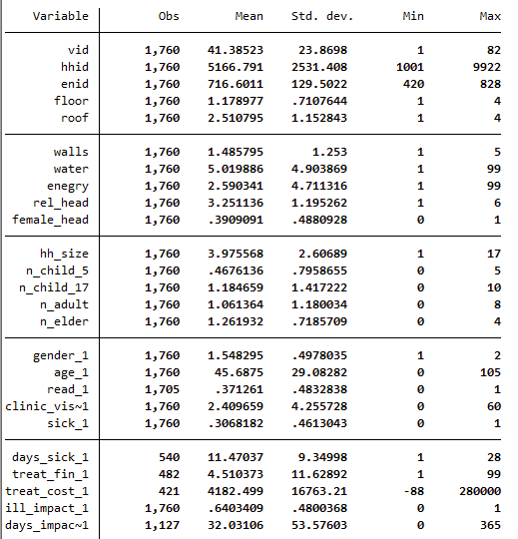
Explore the data

Slide 40
Exploring the data: describe
describe is giving us the following information about the dataset:
Variable names: the names we use to reference a column in Stata
Storage types: the type of information that the data contains – is it a number? A text?
Display formats: how that number is formatted so that we humans can best interpret it – how many decimals are shown, for example
Value labels: the names used for humans to best interpret the values in this variable – more about this soon
Variable labels: the description of the column, or the names that we would use to reference a column to other humans

Slide 41
Exploring the data: describe
describe is useful to identify types of variables
Variables whose storage type starts with str are string variables, that is, they contain text
They are not shown when we use summarize - because Stata does not know how to calculate the average of a text
Variables with value labels are categorical variables
This is why when we use summarize on these variables, we get results that are not very meaningful: because the numbers are only stand-ins for categories

Slide 42
Task 3A: Explore numeric variables
Based on what we saw in the result for describe, we can tell which variables are numeric:
Use the command codebook, to see some general information about the variables hh_size, livestock_now
What is the range of this variable?
How many unique values are there?
Are there any missing values? How are they displayed in the dataset?
Use the command summarize to explore the distribution of the same variables
What is the mean and standard deviation of these variables?

Slide 43
Subsetting observations
The expression if allows us to subset observations, that is, we can choose observations based on a logical condition.
For example, if we wanted to see all the observations in the data set for which the total number of members in the household is 1
browse if hh_size == 1
Note that we wrote == instead of =. This is because we are performing a logical operation. We will talk more about these expressions soon.

Slide 44
Task 3B: Explore numeric variables
Another, perhaps more intuitive way to present numeric variables is through graphs
Create a histogram of the variable food_cons
The command to create histograms is called, not surprisingly, histogram
This command has only one required argument: the name of the variable for which we want to create a histogram
What does the graph look like, particularly the x-axis?
Can you improve it?
Improve the graph by displaying the values without outliers
To do this, we can use the same strategy that we used before to subset observations: an if statement

Slide 45
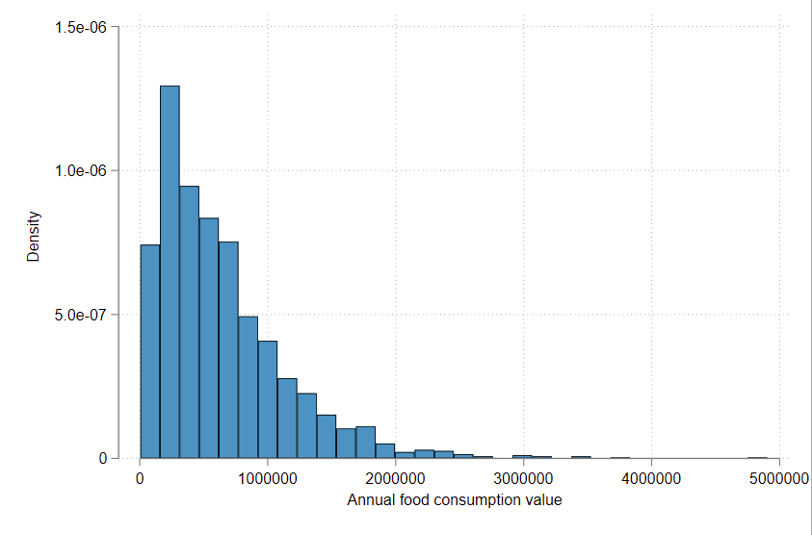
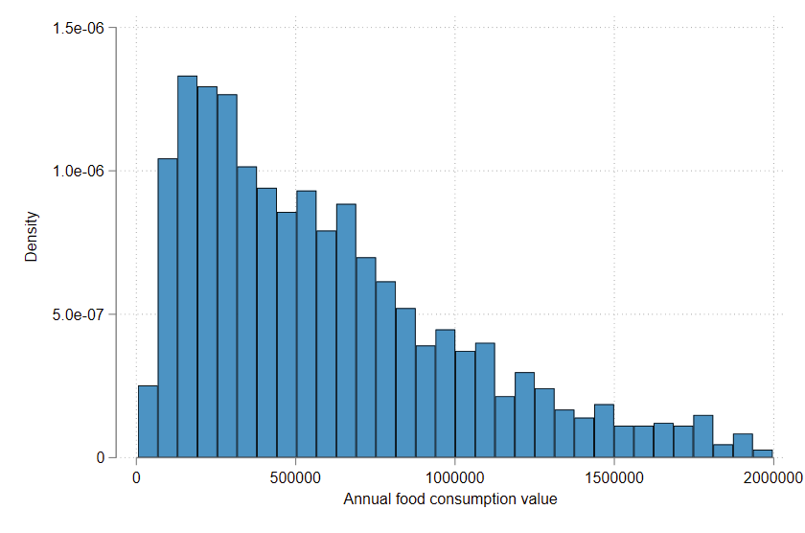
Explore numeric variables
histogram food_cons
histogram food_cons if food_cons < 2000000

Slide 46
Exploring text variables
As we mentioned when discussing the command describe, text variables can be identified by the their “string” type
These variables typically have a large number of unique values
There are not many statistical analysis that we can do with string variables in Stata
But they may still be useful to include in a data set, particularly for the purpose of identifying information

Slide 47
Task 4: Explore string variables
Use codebook to explore string variables crop_other
What is the type of these variables?
How many unique values are there?
Are there any missing values?

Slide 48
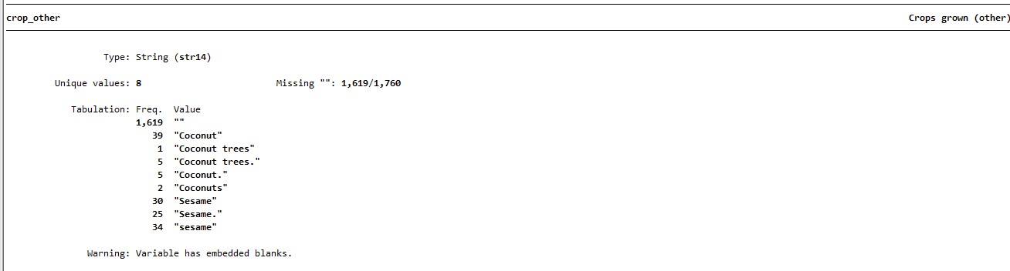
Exploring string variables

Slide 49
Exploring text variables
The “type” of variable starts with “str” and is followed by the maximum number of characters in the variables
Missing values are represented by "" instead of .
By default, Stata shows random examples of values in text variables
As mentioned earlier, the easiest way to interact with these variables in Stata is to browse them

Slide 50
Task 5A: Explore categorical variables
As we noted when using describe, one way to identify categorical variables is when they have value labels.
Use codebook to inspect the categorical variables rel_head, assoc
What all information do you see?
How is it different from other types of variables (like numeric variables)?

Slide 51
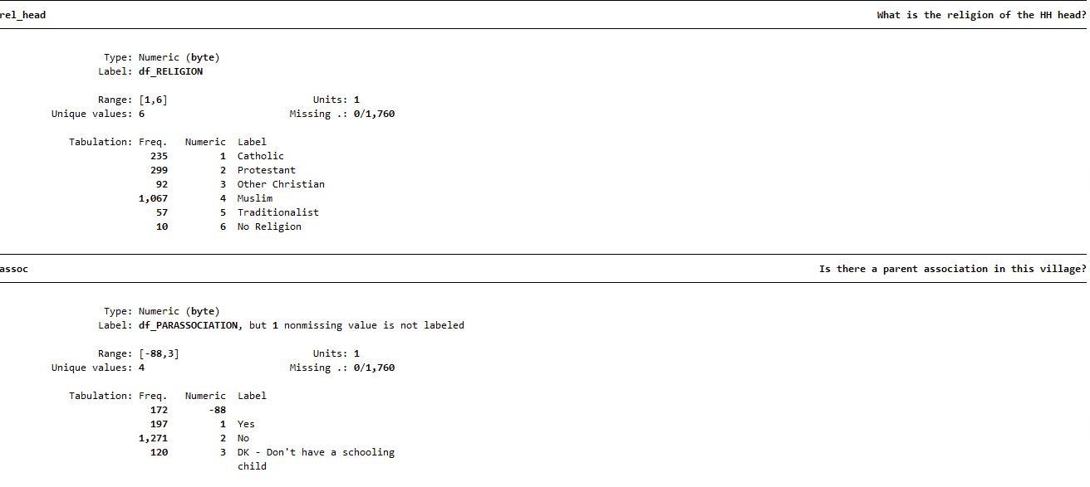
Explore categorical variables

Slide 52
Exploring categorical variables
Some information here is common to all types of data:
We see the type of variable
The number of unique values is shown
We can also see the number of missing values
Most of the information in the codebook is very similar to that of numeric variables:
The type of variable is numeric
We see the range of values it takes
Missing values are represented by .
However, some information is unique to this type of variable:
We see a frequency table instead of summary statistics of random examples
The name of the value label is indicated

Slide 53
Exploring categorical variables
As you can see, having value labels is a very important feature of categorical variables
Just like Stata refers to variables by their variable names and humans refer to them using variable labels, Stata will refer to the different categories in a categorical variable using numbers, while humans will refer to them using value labels
This is because humans understand descriptive names better than numbers, but that is not the case for computers (computers can’t make much sense of natural language, this is why Stata cannot summarize text variables)
We connect a label to each value a categorical variable may take so both humans and computers can understand them

Slide 54
Task 5B: Explore categorical variables
Use labelbook to see the definitions of the value labels for rel_head
How is each category being labeled?
Use tabulate to see the number of observations for each of categories for rel_head
Use the option nolabel with the tabulate command
This is an optional argument of the command, this means we will use a comma (,) to separate it from the other arguments
How does the output differ in this case?
We can also explore the relationship between two categorical variables using tabulate:
Use the tabulate command to explore how the variables rel_head and female_head are related

Slide 55
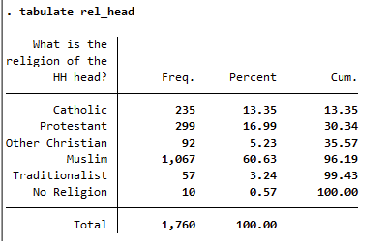
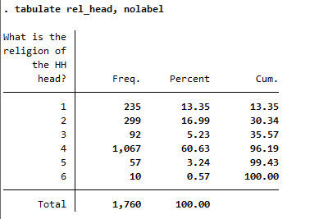
Exploring categorical variables
The command tabulate counts the number of observations that take each value in a categorical variable
Note that when we inspect this variable, we are shown the labels of the category automatically
This is how Stata reads this variable
For us, however, this is much less informative

Slide 56
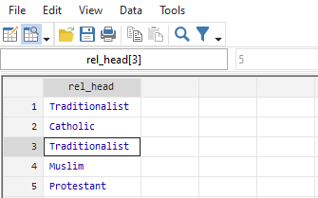
Exploring categorical variables
When we open the dataset, we also see the value label. But when we click on a specific observation for that variable, we can see the underlying numeric value.
browse rel_head

Slide 57
Exploring categorical variables
In summary:
The numbers we see in categorical variables don’t have any meaning
They are only a way for Stata to store and handle the data efficiently
What we humans care about are the categories they represent
A value label is what connects the number that Stata understands to a category that we humans are interested
When communicating to Stata, though, we will refer to the categories using the numbers that represent them

Slide 58
Logical operators and if statements
We can use the if statement we learned earlier to investigate specific cases in a categorical variables
As we have seen, if statements evaluate logic statements and return observations for which these statements are true. Stata accepts the following logical operators:
a == b | True if a is equal to b
a != b | True if a is different than b
a > b | True if a is greater than b
a >= b | True if a is greater than or equal to b
a < b | True if a is less than b
a <= b | True if a is less than or equal to b
a & b | True if a and b are true
a | b | True if a or b are true
!a | logical negation; true if a is false

Slide 59
Task 5C: Explore categorical variables
When giving instructions to Stata, we will refer to a category by its underlying number
Print a frequency table of rel_head when the head of the household is female
Hint: Use the tabulate command with an if statement
count observations where the household head is female, and the number of household members exceeds 5.
count observations where the household head is female, or the religion of the household head is Catholic

Slide 60
Opening Non-Stata Datasets

Slide 61
Open non-Stata datasets
The data that was used to create the Stata data set we have been using until now was originally received in Excel format
This raw data is stored in Raw folder
Raw data means data that is in the originally received format, with no processing by our team
However, for the reasons we have already discussed, we have chosen not to work with this data in Excel
So, we need to do is to open this data into Stata
We will do this using the command import excel

Slide 62
Task 6A: Open excel data
Use import excel to load the excel data treat_status.xlsx from the raw folder
Tip: if you are not sure how to do this, start by looking at the help file
help import excel

Slide 63
Task 6B: Save dataset
Now that we have the data in Stata’s memory, we will make sure to save it in a Stata-friendly format
The native Stata format is called .dta
Save data in memory to file
save [filename] [, save_options]

Slide 64
Main do-files

Slide 65
What are main do-files?
It serves three purposes:
It runs all necessary do-files for data work efficiently and reproducibly.
It establishes a consistent workspace by configuring settings, installing programs, and defining globals.
It maps all files within the data folder and serves as the starting point to find any do-file, dataset or output.

Slide 66
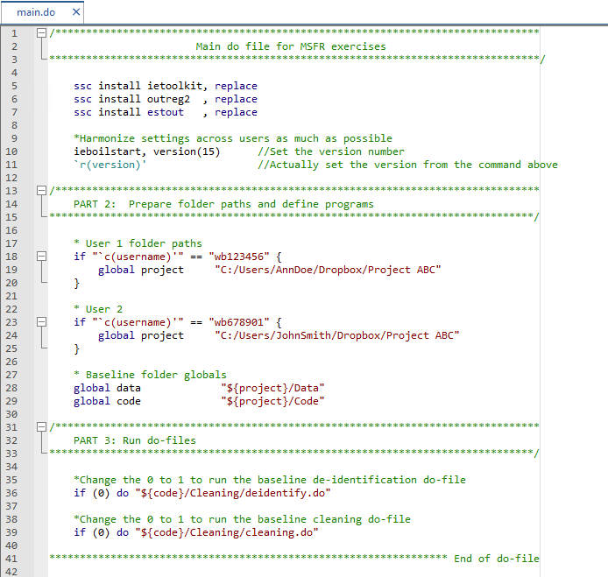
Components of a main.do
Intro header
Install packages or user written commands
Settings
Set Root folder paths
Set Project Folder globals
Run do-files

Slide 67
File paths & globals
globals: save some information (text or number) that you can reference later.
Example, we want to access files in the folder multiple times. We can store the folder location in a global and use it multiple times.
Absolute file paths: define a location starting from a disk in Windows (C:/) or the folder /Users/in Mac.
For example: C:/Users/wb123456/Data/Raw/treat_status.xlsx
Relative file paths: define the location of a file relative to an "anchor" location.
For example: wb123456/Downloads/treat_status.xlsx is the relative path of treat_status.xlsx with respect of C:/Users

Slide 68
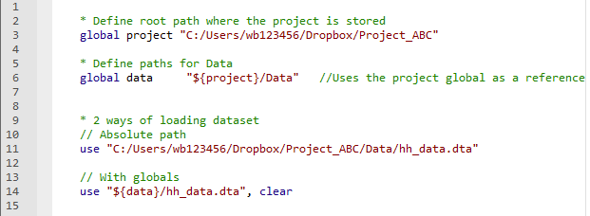
File paths and globals
Once you define your root path in a global, you can use the global as a reference
globals are referenced using $

Slide 69
Task 7: Set up main.do
Locate the main.do file for the course
Change the file paths to match the file path on your local machine
Install packages iefieldkit and ietoolkit
ssc install xxx, replace
Edit lab1.do to update the folder paths when loading and saving the datasets and save the changes
Run lab1.do from main.do

Slide 70
Recap
We have learned:
How the Stata interface is organized
Different ways to interact with Stata
Exploring the dataset
How data can be stored in different formats
How to find help
Setting up and using main do files

Slide 71
Thank you!

Slide 72
Further Reading
https://worldbank.github.io/dime-data-handbook/resources.html
https://worldbank.github.io/dime-data-handbook/

Slide 73
Appendix

Slide 74
Macros in Stata

Slide 75
Macros
Macros (globals and locals) save some information (text or number) that you can reference later.
Example, we want to access files in the folder multiple times. We can store the folder location in a global and use it multiple times.
Globals persist until you terminate the Stata session, so you will need to be more careful using these
Locals “expire” when the program is done running and are deleted from memory immediately.

Slide 76
Code syntax: Macros
Defining globals/locals
local lname “string”
local lname = expression
global gname “string”
global gname = expression
Referencing globals/locals:
Local: `lname’
Gobals: $gname

Slide 77
Task 8A: Define locals
Most estimation commands return results into a temporary location in the Stata environment. You can see what is there by typing return list or ereturn list.
summarize food_cons
Type return list to see the stored results
Create a local called mean_food_cons that stores the mean of the variable food_cons
Use the command display to print the mean stored in the local

Slide 78
Task 8B: Define global
Set your working directory using a global:
Create a global that contains the filepath to the DataWork folder. Call the global datawork
To check what is stored in your global, type this in the command window and hit enter:
display “${datawork}”
Update the use commands in your do-file with the global you created. Then re-run your code to make sure that it works with the new file paths!

Slide 79
Code syntax: Macros
Stata quotes:
Equals sign
Referencing locals | What it stores
local NAME “STRING” | STRING in `NAME’
local NAME `““STRING””’ | “STRING” in `NAME’
local NAME `=2+2’ | 4
Referencing locals | What it stores
local NAME = min(2,3,4) | 2 in `NAME’
local NAME = “min(2,3,4)” | min(2,3,4) in `NAME’

Slide 80
Code syntax: Referencing variables
Referencing Variables | Description
myvar | just one variable
myvar thisvar thatvar | three variables
myvar* | variables starting with myvar
*var | variables ending with var
my*var | variables starting with my & ending with var with any number of other characters between
my?var | variables starting with my & ending with var with one other character between
myvar1-myvar6 | myvar1, myvar2, ..., myvar6 (probably)
this-that | variables this through that, inclusive

Slide 81
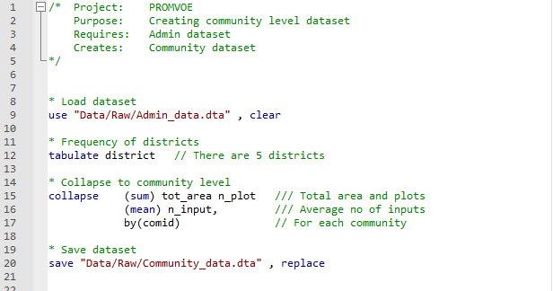
Commenting do-files
When writing a do-file, it is very useful to be able to add notes and comments in natural language, that is, in English or Portuguese
We use a few special characters to tell Stata what parts of a do-file it should run, and what parts is should ignore:
/* comment */ Used for long comments or to explain many lines of code
* comment Used to explain what happens on the following few rows
// comment Used to explain the same line of code

Slide 82
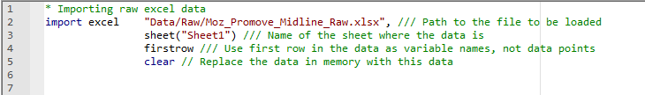
Break up long lines of code
One should never have to scroll horizontally to be able to read code
Use triple-slash: ///
Everything afterwards on the same row will be interpreted as a comment
The following row will be interpreted as if it was the same row
Good for breaking a long line of code into a few rows

Slide 83
Write code for others to read
Is this easy to read?
White Space. Stata does not distinguish between one empty space and many empty spaces, or one line break or many line breaks. It makes a big difference to the human eye, and we would never share a Word document, an Excel sheet or a PowerPoint presentation without thinking about white space - although we call it formatting.

Slide 84
White Space
Stata does not distinguish between one empty space and many empty spaces, or one line break or many line breaks
It makes a big difference to the human eye, and we would never share a Word document, an Excel sheet or a PowerPoint presentation without thinking about white space – although we call it formatting

Slide 85
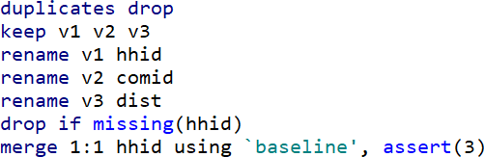
Vertical Spacing
Before vertical spacing

Slide 86
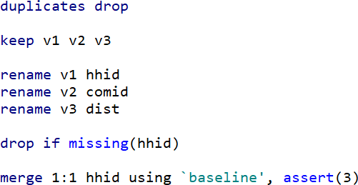
Vertical Spacing
Before vertical spacing
After vertical spacing

Slide 87
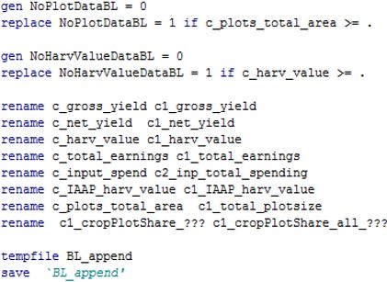
Horizontal Spacing
Before horizontal spacing

Slide 88
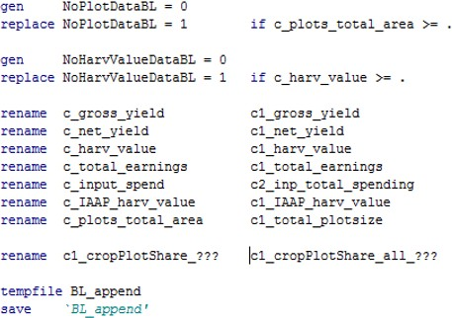
Horizontal Spacing
Before horizontal spacing
After horizontal spacing

Slide 89
Style Guides
Style guides are common in most programming languages
Following a style guide will make your code much more readable, and it will reduce the risk of errors
Stata style guide: https://worldbank.github.io/dime-data-handbook/coding.html

